Slide 1
Automatic Test Grading Using Image Processing and Machine Learning Techniques
AP Smit

Slide 2

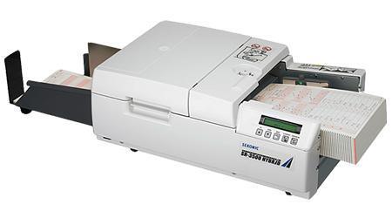
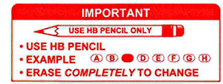
Problem statement
Problem
Large student numbers prevents online test in one location. Large numbers of tests that the tutors (demies) must grade.
Tutors and teaching assistant grade tests incorrectly
Online tests increases the chance of cheating
Current OMR systems require special scanners
Current OMR systems are difficult to use

Slide 3
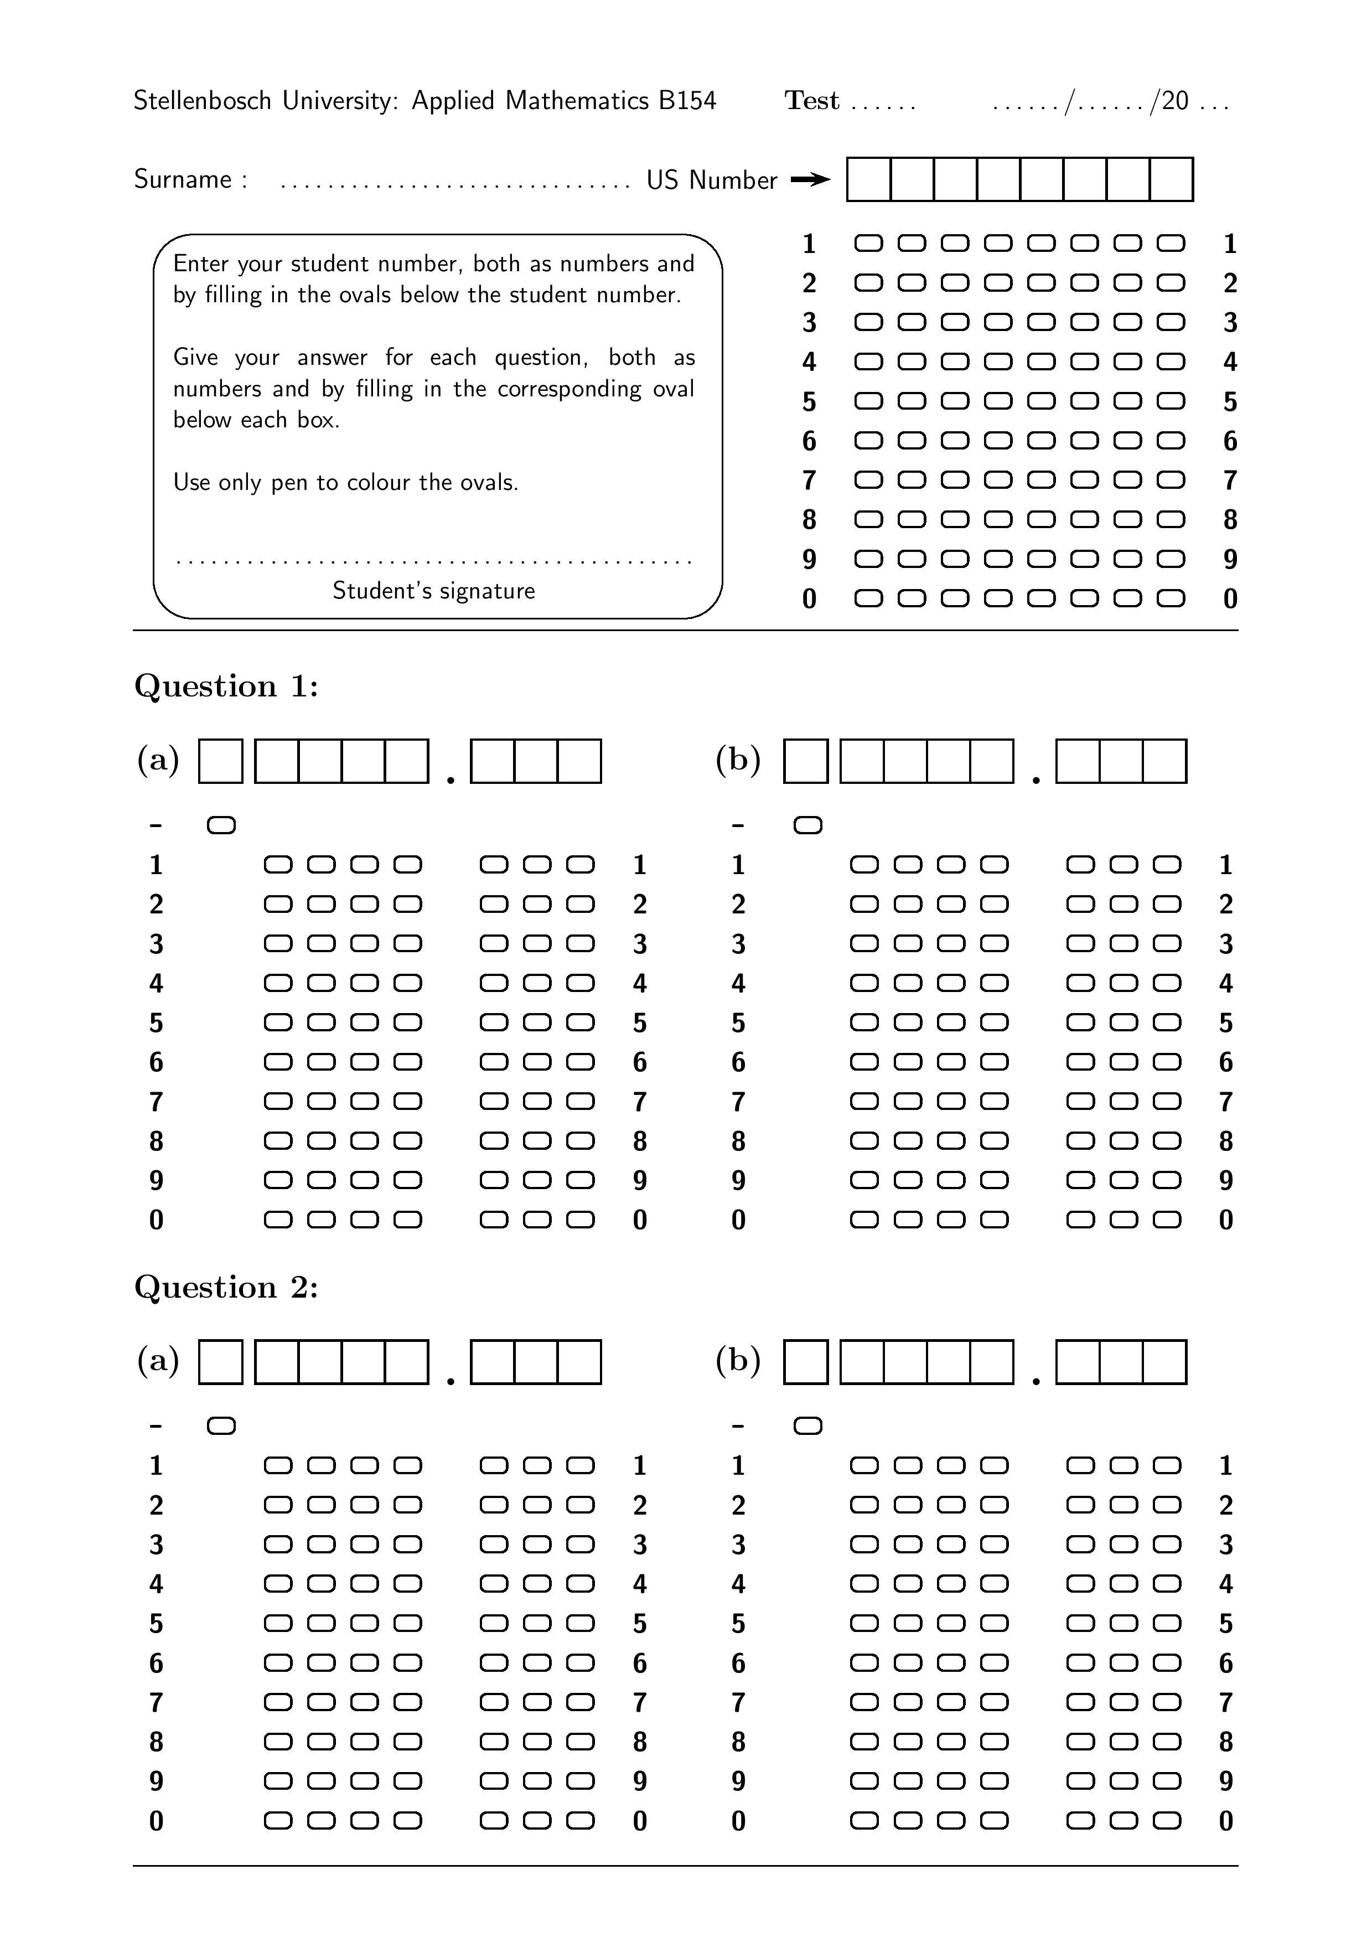
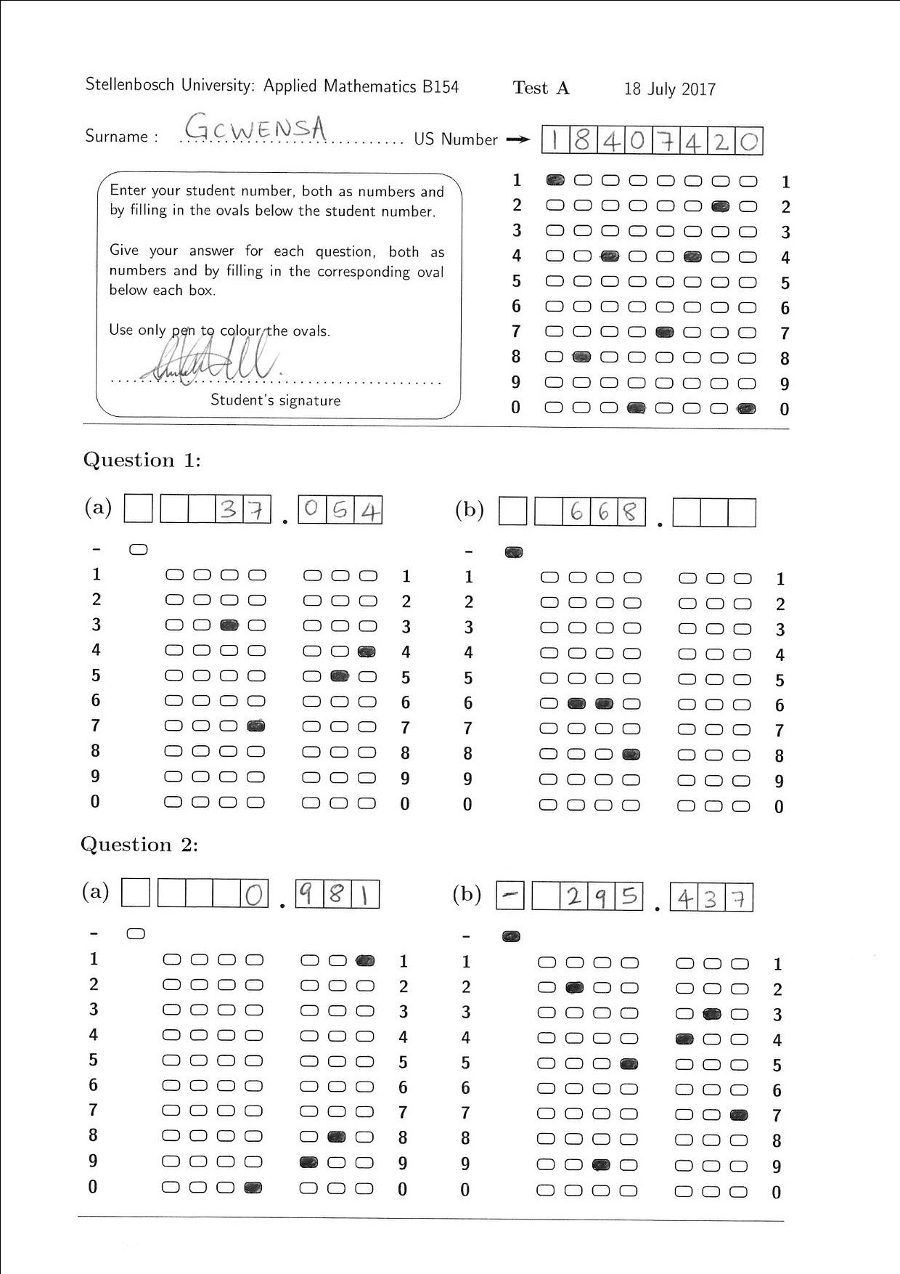
Solution
Template that grades decimal valued answers
Software that can handle crossed-out answers
Allow for numbers characters to be filled-in, increasing reliability.

Slide 4
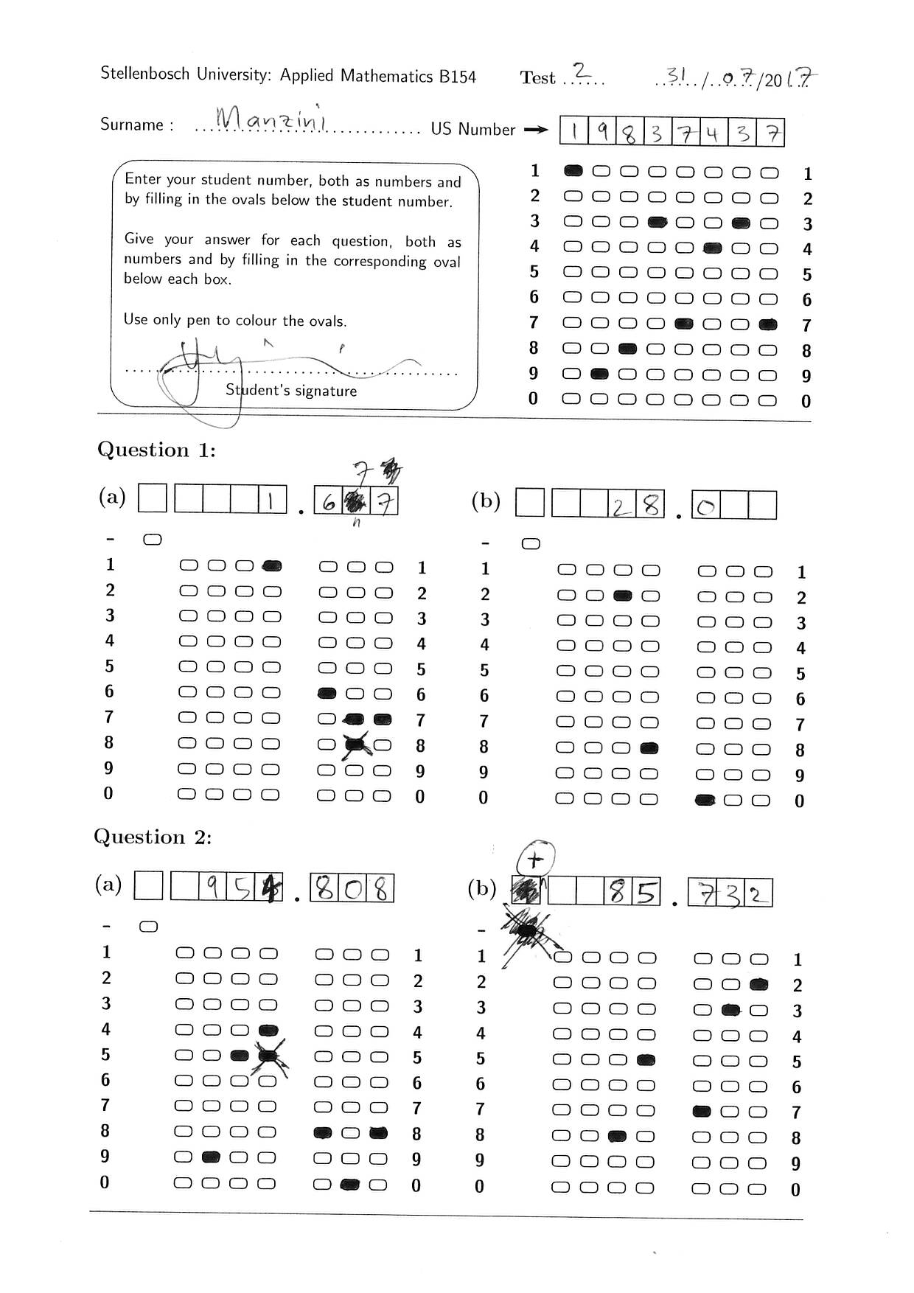
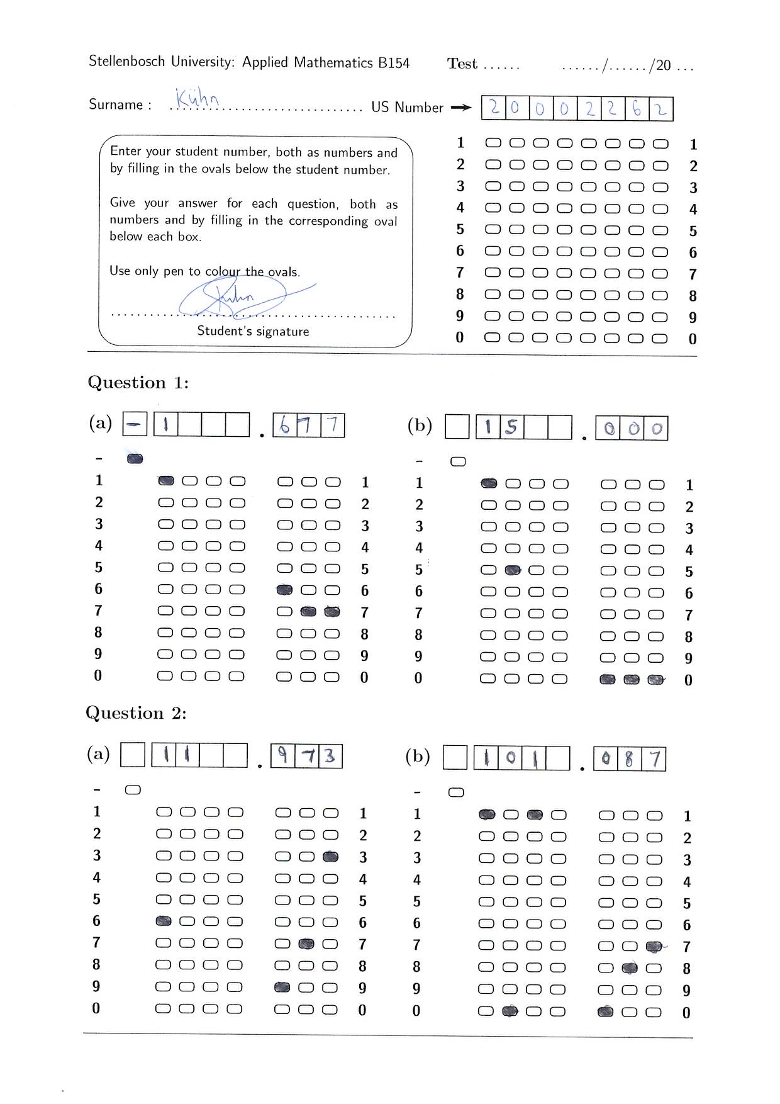
Solution

Slide 5
Image Processing

Slide 7
Machine learning: Neural Network

Slide 8
Machine Learning: Probabilistic Graphical Models

Slide 9
Results

